Slide 1

Movie Guru
Group no.1
Ophelia, Jucary, Mohan, Dalton, Ali
Aug. 2021

Slide 2
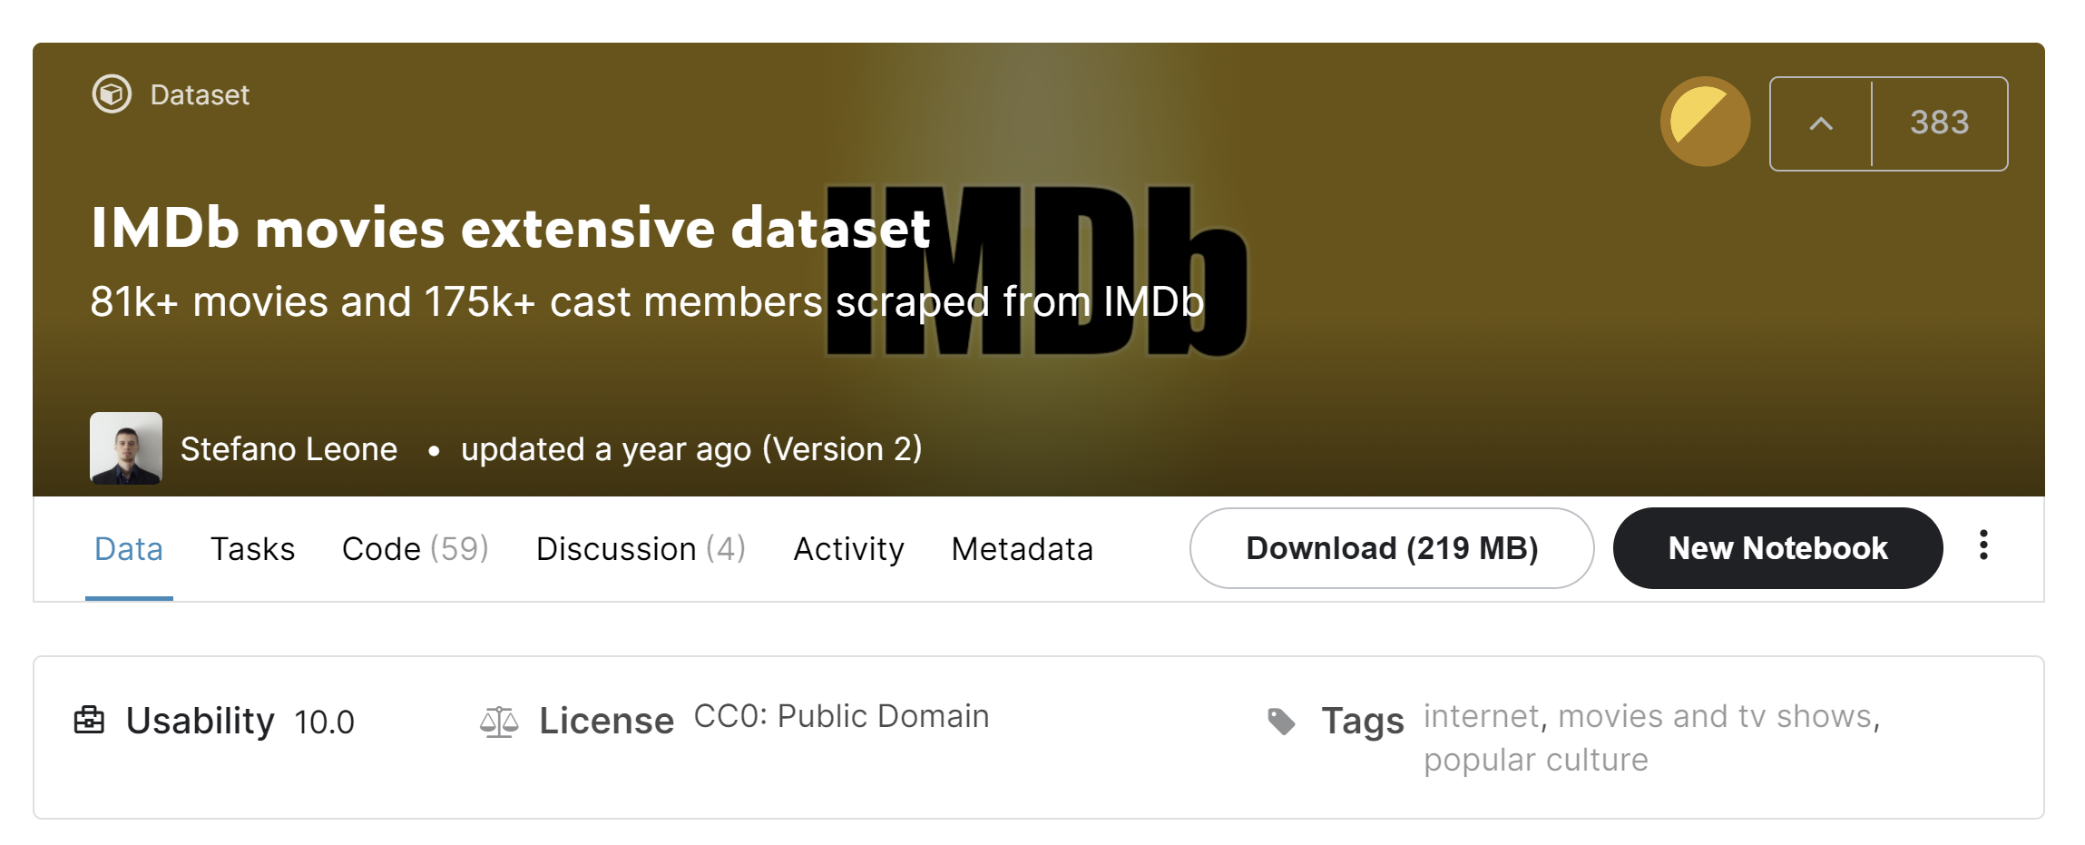
Description
Several project ideas and stories discussed such as internet band width in different states; finally, we chose IMDB data source from Kaggle.com to explore :
- allocate the no. of movies produced in each country on the map.
- average rating of each genre in different countries
- number of films in different genre in each country

Slide 3
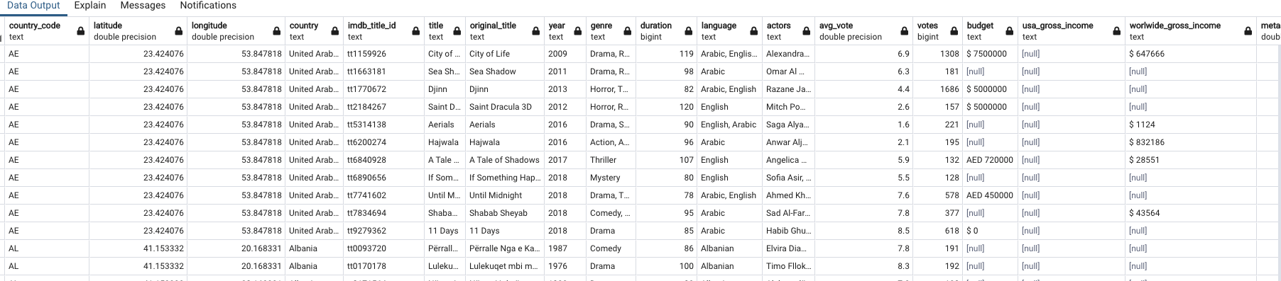



ETL
Import .csv data to Jupyter notebook
Merged the IMDB Films dataframe with the Latitude and Longitude dataframe.
Dropped columns and found unique data; split cells strings to structure data source.
Create database in PostgreSQL and generate engine using Pandas
ETL process complete

Slide 4
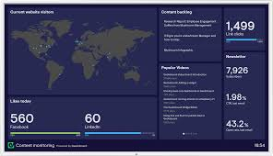




Flow chart
CSV file
Chose column for analysis
Import data in jupyter notebook
Merge different DB’s
Structure the data
Create database in PostgreSQL and generate engine
ETL complete
(Cleaning-notebook.ipynb)
Create flask api to call data
(app.py)
Create dashboard HTML , CSS files
Create JS file
Create Leaflet map
Implement ChartJs for visualization
(logic.js)
(index.html)

Slide 5



Coding journey
Set up Git LFS
Pandas and PostgreSQL for ETL
Create Flask api with many routes (“/”, ”/<genre name>”, ”/country/<country name>” etc.) to call data from database
Create dashboard with HTML & CSS files using Jinja template & Bootstrap
Landing Page: Create Leaflet map with dynamic size circle based on total no. of produced films in a country. Use size scaling for better visualization
Event handling: Use d3 to respond to data selected from dropdown menu
Implement ChartJS for dynamic visualization on 2 bar charts

Slide 6
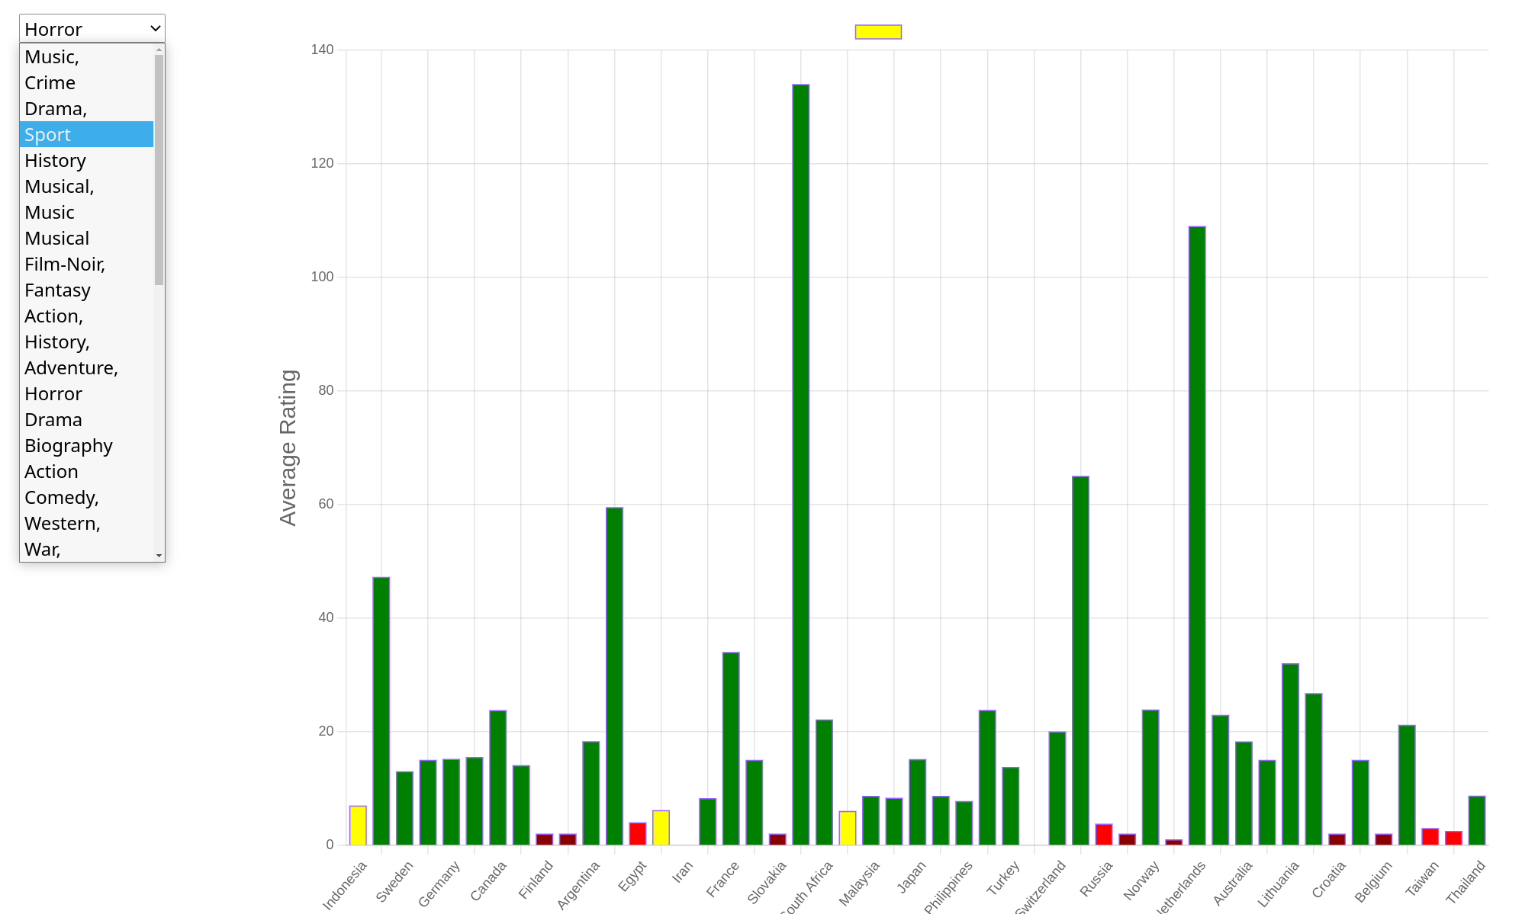
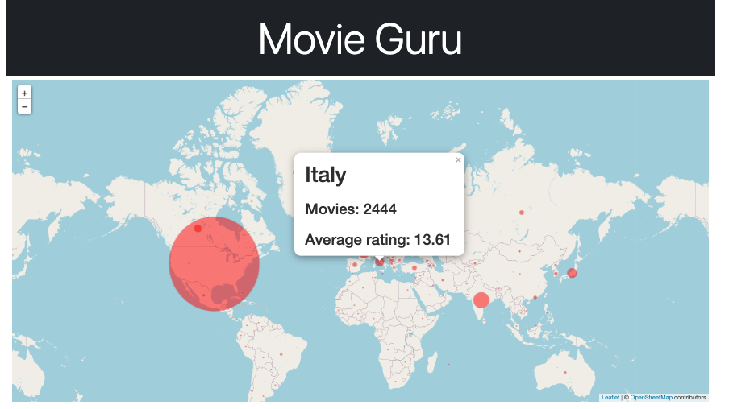
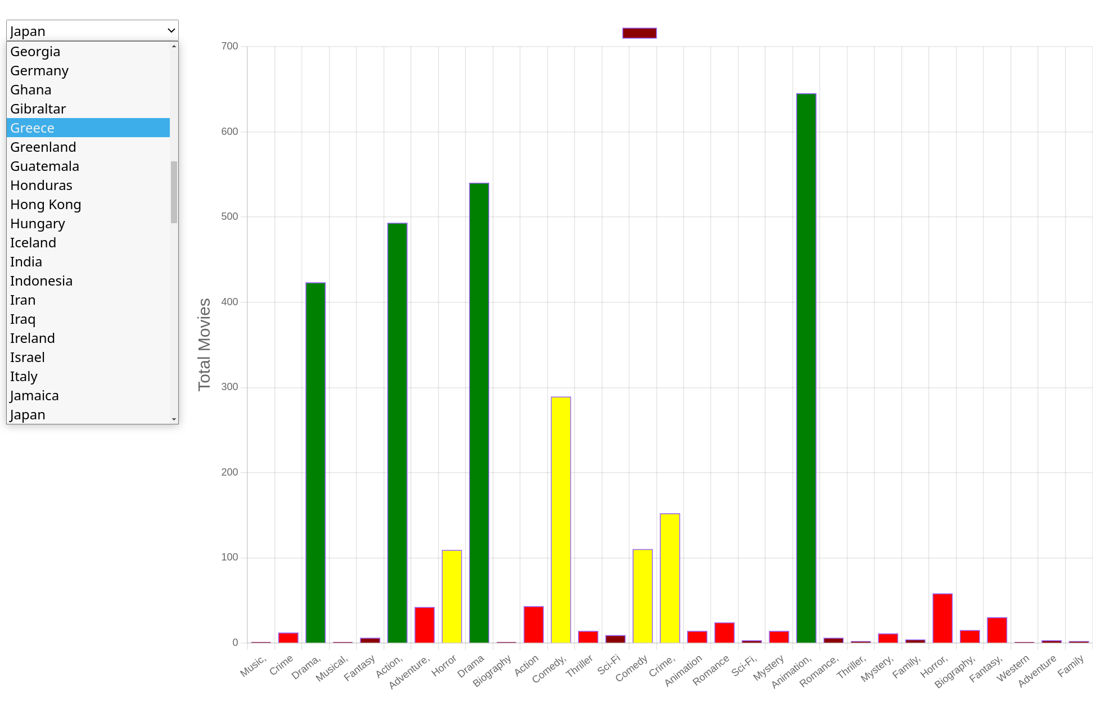
Visualization journey
Average rating for genre selected in dropdown for each country
ChartJS is a new library not covered in the class
Flask api route (“/<genre_name>”) used to query for the data grouped by country
Leaflet Map showing movies produced in each country
USA > India > Japan > France > Italy
Flask api route (“/”) to render data on landing page
Total movies in each genre for country selected in dropdown
Flask api route (“/country/<name>”) used to query for the data grouped by genre

Slide 7
Challenges
Large datafiles handled with Git LFS
Connecting to PostgreSQL and loading data with pandas
Querying database with pandas “ ” vs ‘ ’ took half of the class time
Not disabling cache on the browser led to a lot of confusion on which file was being run
Leaflet CSS on height scaling was not obvious
Learning ChartJS syntax and enabling the charts (thank you Justin!!)
Change in git push procedures starting Aug 13, 2021 with tokens took additional time
Setting up/visualizing the architecture for the project was challenging at the beginning of the project

